Slide 1

DC Circuits
Parallel Circuits
By Dr. Ahmed S. Abdullah
د. احمد سليمان عبدالله

Slide 2
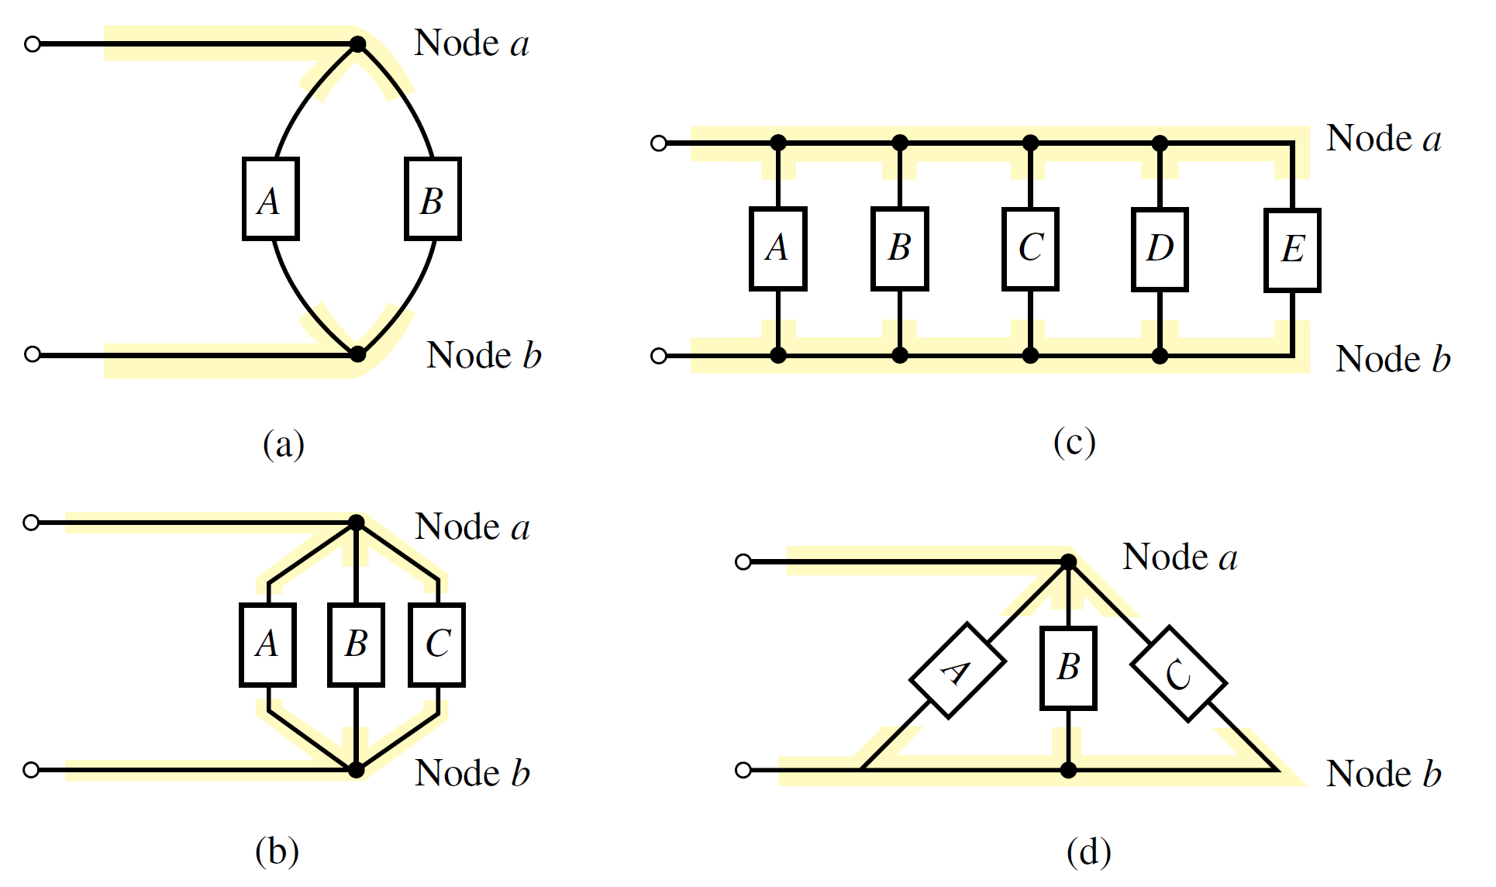
Parallel Circuits
Elements or branches are said to be in a parallel connection when they have exactly two nodes in common.
Figure shows several different ways of sketching parallel elements. The elements between the nodes may be any two-terminal devices such as voltage sources, resistors, light bulbs, and the like.

Slide 3
Parallel Circuits
Elements or branches are said to be in a parallel connection when they have exactly two nodes in common.
Figure shows several different ways of sketching parallel elements. The elements between the nodes may be any two-terminal devices such as voltage sources, resistors, light bulbs, and the like.

Slide 4
Parallel Circuits
Elements or branches are said to be in a parallel connection when they have exactly two nodes in common.
Figure shows several different ways of sketching parallel elements. The elements between the nodes may be any two-terminal devices such as voltage sources, resistors, light bulbs, and the like.

Slide 5
Parallel Circuits
Elements or branches are said to be in a parallel connection when they have exactly two nodes in common.
Figure shows several different ways of sketching parallel elements. The elements between the nodes may be any two-terminal devices such as voltage sources, resistors, light bulbs, and the like.

Slide 6
Parallel Circuits
By finding the reciprocal of the resistance of a material, we have a measure of how well the material will conduct electricity. The quantity is called conductance, has the symbol G, and is measured in siemens (S)

Slide 7
Parallel Circuits
By finding the reciprocal of the resistance of a material, we have a measure of how well the material will conduct electricity. The quantity is called conductance, has the symbol G, and is measured in siemens (S)
For parallel elements,
the total conductance is:-

Slide 8
Parallel Circuits
By finding the reciprocal of the resistance of a material, we have a measure of how well the material will conduct electricity. The quantity is called conductance, has the symbol G, and is measured in siemens (S)
For parallel elements,
the total conductance is:-

Slide 9
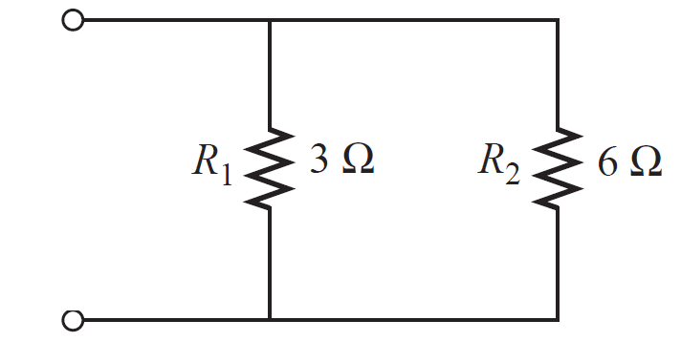
Parallel Circuits
EXAMPLE Determine the total conductance and resistance for the parallel network of Figure shown

Slide 10
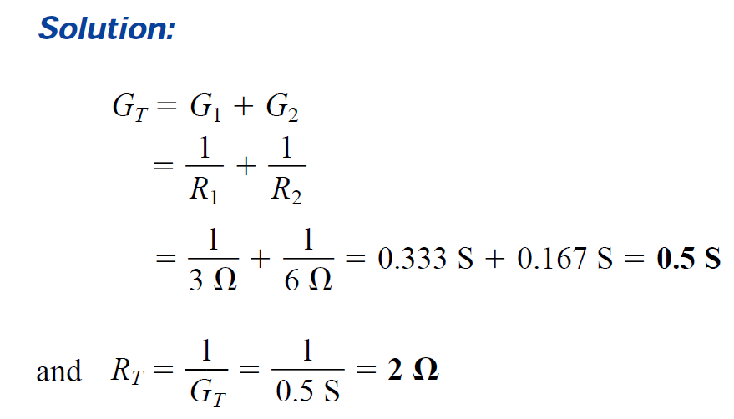
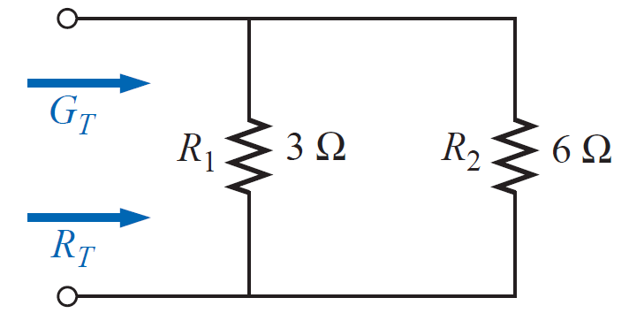
Parallel Circuits
EXAMPLE Determine the total conductance and resistance for the parallel network of Figure shown

Slide 11
Parallel Circuits
EXAMPLE Determine the total conductance and resistance for the parallel network of Figure shown

Slide 12
Parallel Circuits
EXAMPLE Determine the total conductance and resistance for the parallel network of Figure shown

Slide 13
Parallel Circuits
EXAMPLE Determine the total conductance and resistance for the parallel network of Figure shown
The total resistance of parallel resistors is always less than the value of the smallest resistor.

Slide 14
Parallel Circuits
For equal resistors in parallel, the equation becomes significantly easier to apply. For N equal resistors in parallel,

Slide 15
Parallel Circuits
For equal resistors in parallel, the equation becomes significantly easier to apply. For N equal resistors in parallel,

Slide 16
Parallel Circuits
For equal resistors in parallel, the equation becomes significantly easier to apply. For N equal resistors in parallel,

Slide 17
Parallel Circuits
For equal resistors in parallel, the equation becomes significantly easier to apply. For N equal resistors in parallel,

Slide 18
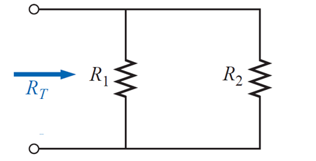
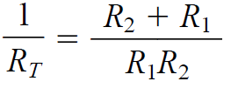
Parallel Circuits
For two parallel resistors, we write
The total resistance of two parallel resistors is the product of the two divided by their sum.
For three parallel resistors, the equation for RT becomes

Slide 19
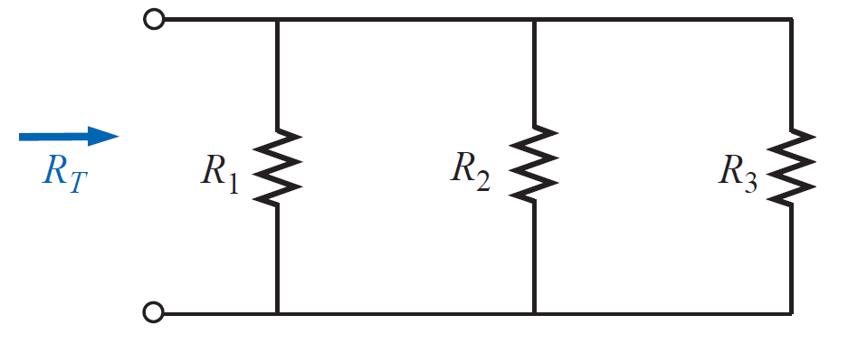
Parallel Circuits
For three parallel resistors, the equation for RT becomes

Slide 20
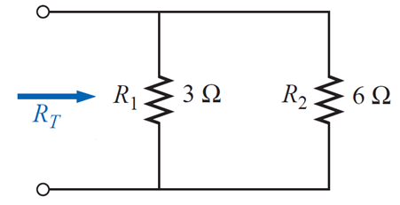
Parallel Circuits
EXAMPLE Determine the total resistance for the parallel network of Figure shown

Slide 21
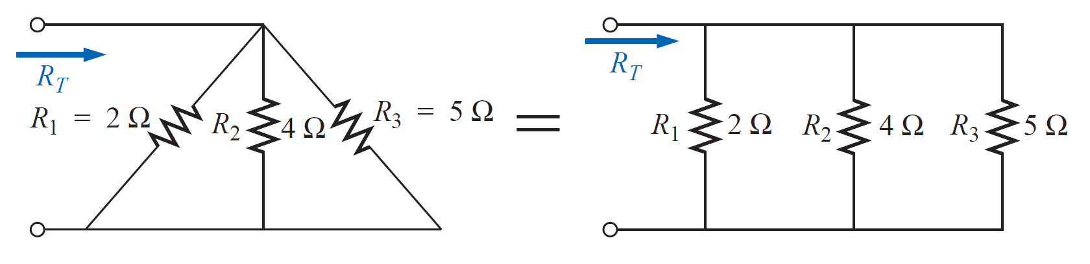
Parallel Circuits
EXAMPLE Determine the total resistance for the parallel network of Figure shown

Slide 22
Parallel Circuits
EXAMPLE Determine the total resistance for the parallel network of Figure shown

Slide 23
Parallel Circuits
EXAMPLE Determine the total resistance for the parallel network of Figure shown

Slide 24
Parallel Circuits
EXAMPLE Determine the total resistance for the parallel network of Figure shown

Slide 25
Parallel Circuits
EXAMPLE Determine the total resistance for the parallel network of Figure shown

Slide 26
Parallel Circuits
EXAMPLE Determine the total resistance for the parallel network of Figure shown

Slide 27

Parallel Circuits
EXAMPLE Determine the total resistance for the parallel network of Figure shown
$$R^{′}=R_{1}{//R}_{2}$$

Slide 28
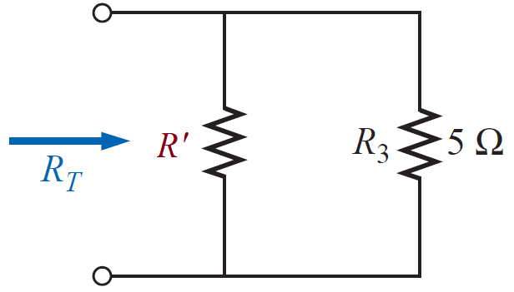
Parallel Circuits
EXAMPLE Determine the total resistance for the parallel network of Figure shown
$$R^{′}=R_{1}{//R}_{2}$$

Slide 29
Parallel Circuits
EXAMPLE Determine the total resistance for the parallel network of Figure shown
$$R^{′}=R_{1}{//R}_{2}$$

Slide 30
Parallel Circuits
EXAMPLE Determine the total resistance for the parallel network of Figure shown
$$R^{′}=R_{1}{//R}_{2}$$

Slide 31
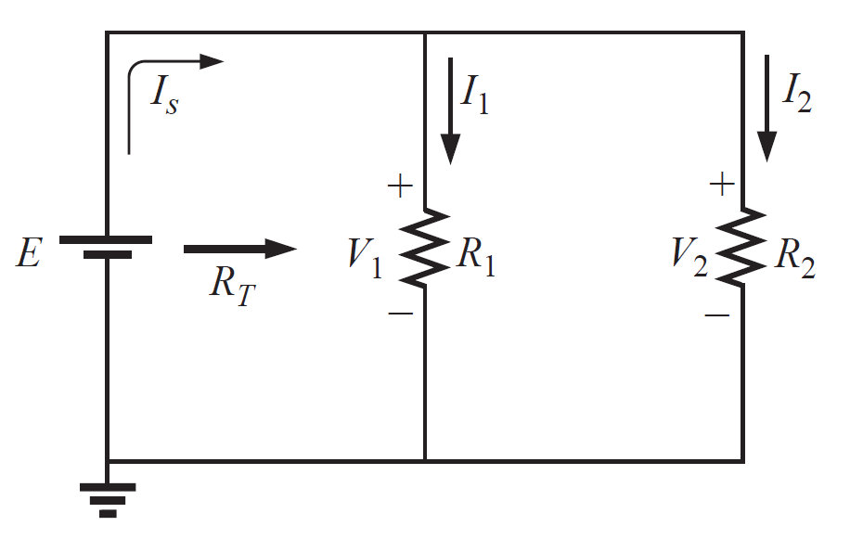
Parallel Circuits

Slide 32
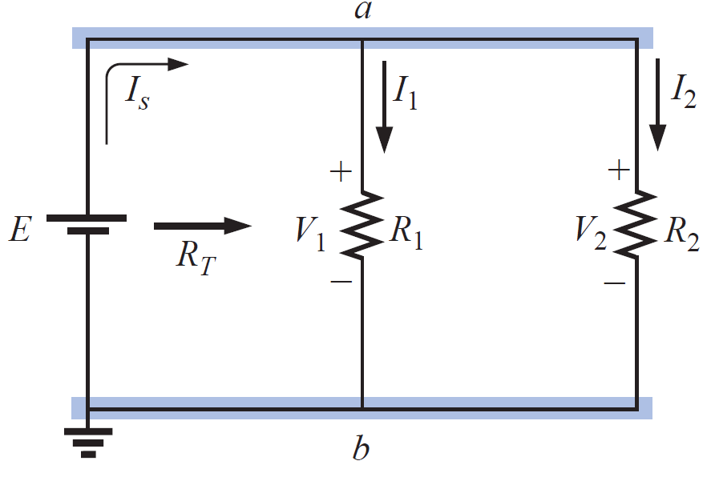
Parallel Circuits

Slide 33
Parallel Circuits
The voltage across parallel elements is the same.
Using this fact will result in

Slide 34
Parallel Circuits
The voltage across parallel elements is the same.
Using this fact will result in

Slide 35
Parallel Circuits
The voltage across parallel elements is the same.
Using this fact will result in
If we take the equation for the total resistance and multiply both
sides by the applied voltage, we obtain

Slide 36
Parallel Circuits
The voltage across parallel elements is the same.
Using this fact will result in
If we take the equation for the total resistance and multiply both
sides by the applied voltage, we obtain
Substituting the Ohm’s law relationships appearing above, we find that the source current

Slide 37
Parallel Circuits
The voltage across parallel elements is the same.
Using this fact will result in
If we take the equation for the total resistance and multiply both
sides by the applied voltage, we obtain
Substituting the Ohm’s law relationships appearing above, we find that the source current

Slide 38
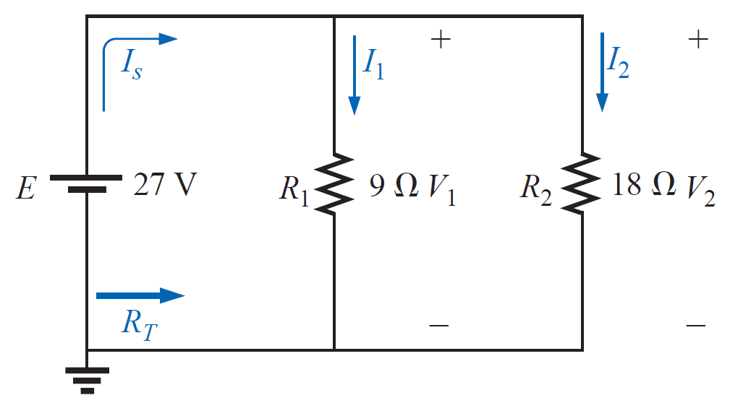
Parallel Circuits
EXAMPLE For the parallel network of Figure shown:

Slide 39
Parallel Circuits
EXAMPLE For the parallel network of Figure shown:

Slide 40
Parallel Circuits
EXAMPLE For the parallel network of Figure shown:

Slide 41
Parallel Circuits
EXAMPLE For the parallel network of Figure shown:

Slide 42
Parallel Circuits
EXAMPLE For the parallel network of Figure shown:

Slide 43
Parallel Circuits
EXAMPLE For the parallel network of Figure shown:

Slide 44
Parallel Circuits
EXAMPLE For the parallel network of Figure shown:

Slide 45
Parallel Circuits
EXAMPLE For the parallel network of Figure shown:

Slide 46
Parallel Circuits
EXAMPLE For the parallel network of Figure shown:

Slide 47
Parallel Circuits
EXAMPLE For the parallel network of Figure shown:

Slide 48
Parallel Circuits
EXAMPLE For the parallel network of Figure shown:

Slide 49
Parallel Circuits
EXAMPLE For the parallel network of Figure shown:

Slide 50
Parallel Circuits
EXAMPLE For the parallel network of Figure shown:

Slide 51
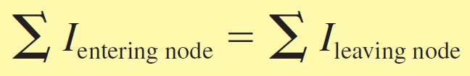
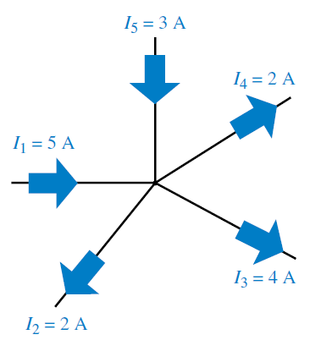
Kirchhoff’s current law (KCL)
Kirchhoff’s current law (KCL)
Kirchhoff’s current law (KCL)
The summation of currents entering a node is equal to the summation of currents leaving the node.

Slide 52
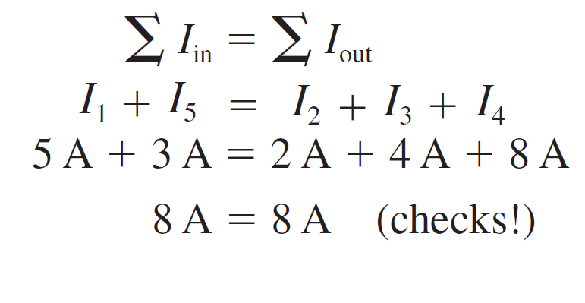
Kirchhoff’s current law (KCL)
Kirchhoff’s current law (KCL)
Kirchhoff’s current law (KCL)
The summation of currents entering a node is equal to the summation of currents leaving the node.

Slide 53
Kirchhoff’s current law (KCL)
Kirchhoff’s current law (KCL)
Kirchhoff’s current law (KCL)
The summation of currents entering a node is equal to the summation of currents leaving the node.

Slide 54
Kirchhoff’s current law (KCL)
Kirchhoff’s current law (KCL)
Kirchhoff’s current law (KCL)
The summation of currents entering a node is equal to the summation of currents leaving the node.

Slide 55
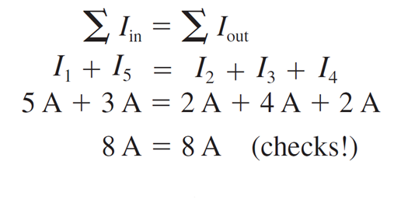
Kirchhoff’s current law (KCL)
Kirchhoff’s current law (KCL)
Kirchhoff’s current law (KCL)
The summation of currents entering a node is equal to the summation of currents leaving the node.

Slide 56
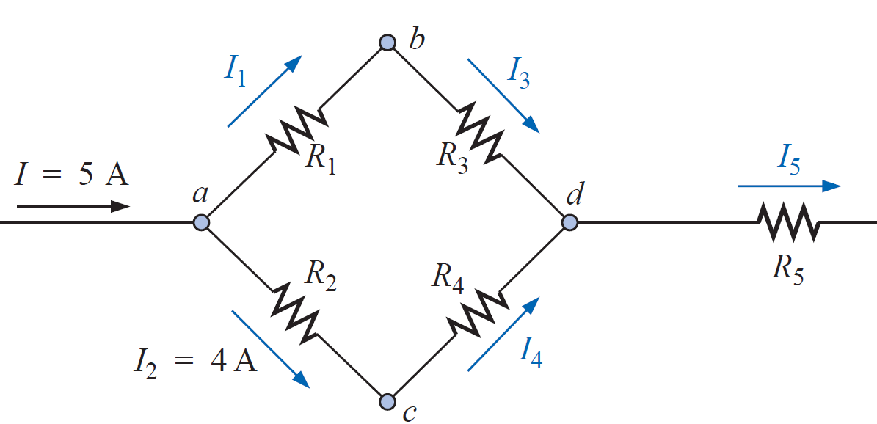
Kirchhoff’s current law (KCL)
EXAMPLE Determine I1, I3, I4, and I5 for the network of Figure shown

Slide 57
Kirchhoff’s current law (KCL)
EXAMPLE Determine I1, I3, I4, and I5 for the network of Figure shown

Slide 58
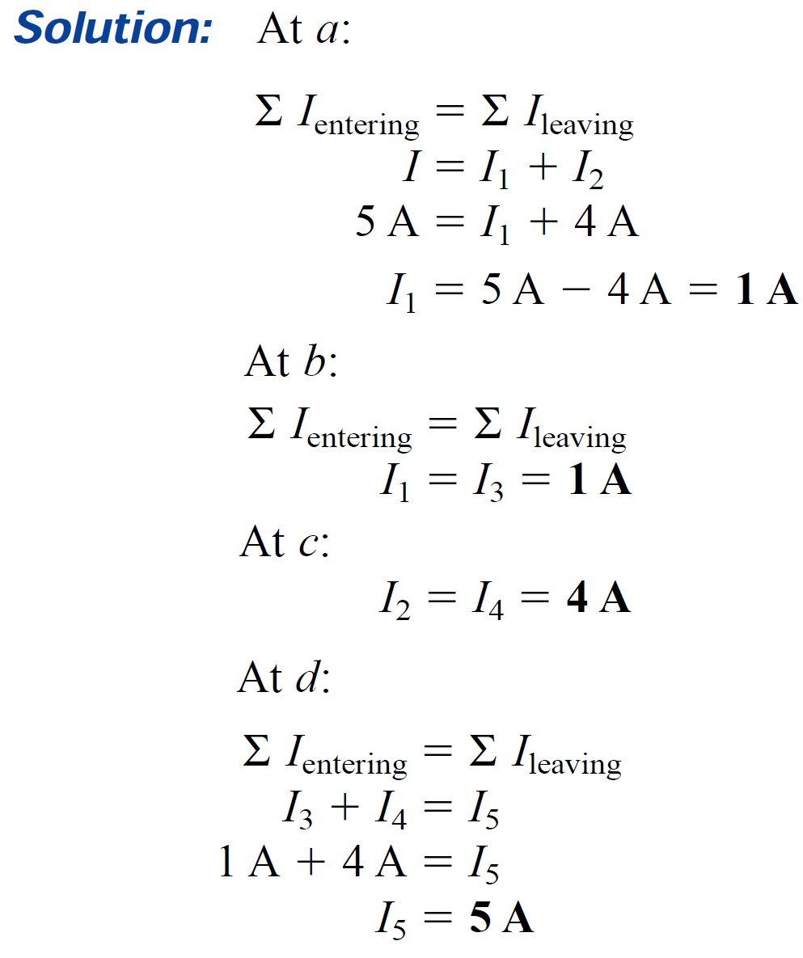
Kirchhoff’s current law (KCL)
EXAMPLE Determine I1, I3, I4, and I5 for the network of Figure shown

Slide 59

Kirchhoff’s current law (KCL)
EXAMPLE Determine I1, I3, I4, and I5 for the network of Figure shown

Slide 60
Kirchhoff’s current law (KCL)
EXAMPLE Determine I1, I3, I4, and I5 for the network of Figure shown

Slide 61
Kirchhoff’s current law (KCL)
EXAMPLE Determine I1, I3, I4, and I5 for the network of Figure shown

Slide 62
Kirchhoff’s current law (KCL)
EXAMPLE Determine I1, I3, I4, and I5 for the network of Figure shown

Slide 63
Kirchhoff’s current law (KCL)
EXAMPLE Determine I1, I3, I4, and I5 for the network of Figure shown
Ok

Slide 64
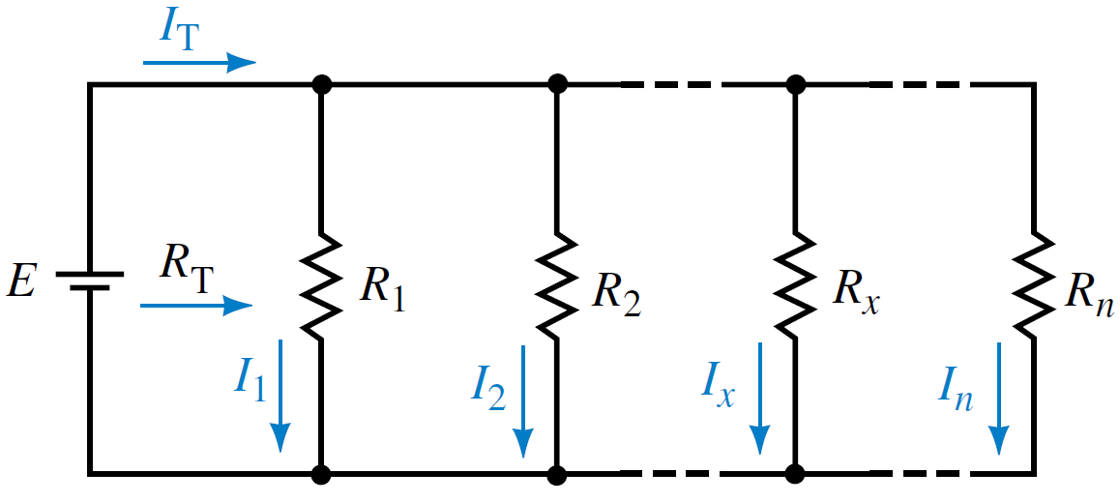
The Current Divider Rule (CDR)
The Current Divider Rule (CDR)
The current divider rule (CDR) is used to determine how current entering a node is split between the various parallel resistors connected to the node.

Slide 65
The Current Divider Rule (CDR)
The total current in the circuit is

Slide 66
The Current Divider Rule (CDR)
The total current in the circuit is
The current through any resistor in the network is given as

Slide 67

The Current Divider Rule (CDR)
The total current in the circuit is
The current through any resistor in the network is given as

Slide 68
The Current Divider Rule (CDR)
The total current in the circuit is
The current through any resistor in the network is given as
We obtain the current divider rule as follows:

Slide 69
The Current Divider Rule (CDR)
We obtain the current divider rule as follows:

Slide 70
The Current Divider Rule (CDR)
We obtain the current divider rule as follows:
The total parallel resistance is given as

Slide 71
The Current Divider Rule (CDR)
We obtain the current divider rule as follows:
The total parallel resistance is given as

Slide 72
The Current Divider Rule (CDR)
We obtain the current divider rule as follows:
The total parallel resistance is given as

Slide 73
The Current Divider Rule (CDR)
We obtain the current divider rule as follows:
The total parallel resistance is given as
which simplifies to

Slide 74
The Current Divider Rule (CDR)
We obtain the current divider rule as follows:
The total parallel resistance is given as
which simplifies to
Similarly,

Slide 75
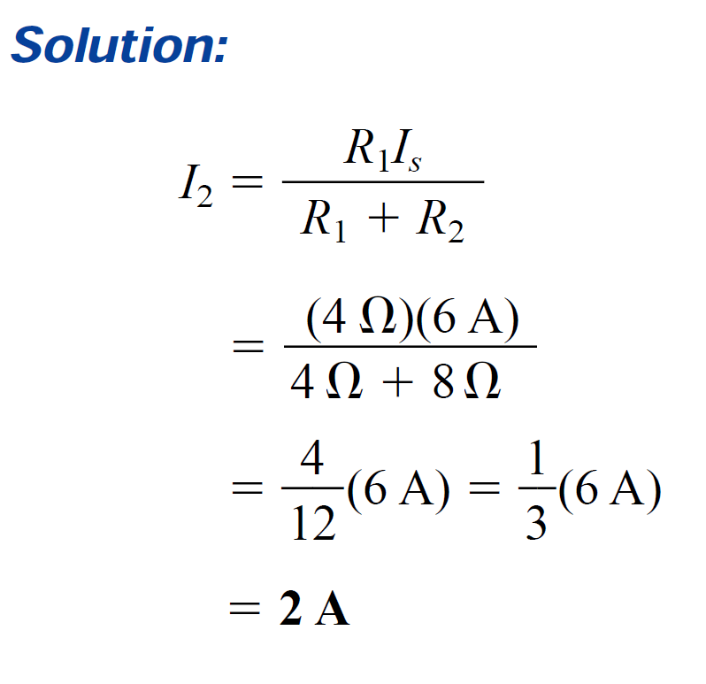
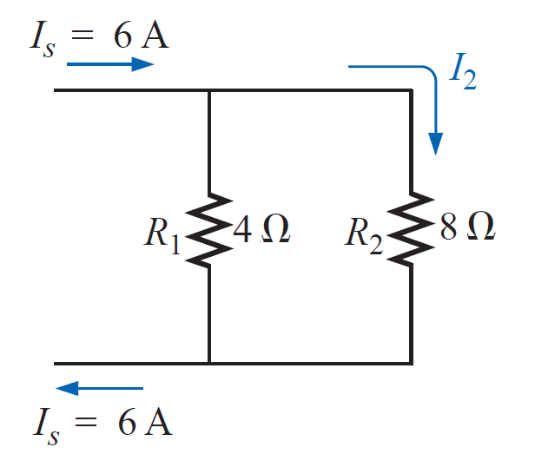
The Current Divider Rule (CDR)
EXAMPLE Determine the current I2 for the network of Figure shown using the current divider rule.

Slide 76
The Current Divider Rule (CDR)
EXAMPLE For the circuit of Figure shown, determine the following quantities:

Slide 77
The Current Divider Rule (CDR)
EXAMPLE For the circuit of Figure shown, determine the following quantities:

Slide 78
The Current Divider Rule (CDR)
EXAMPLE For the circuit of Figure shown, determine the following quantities:

Slide 79
The Current Divider Rule (CDR)
EXAMPLE For the circuit of Figure shown, determine the following quantities:

Slide 80
The Current Divider Rule (CDR)
EXAMPLE For the circuit of Figure shown, determine the following quantities:

Slide 81
The Current Divider Rule (CDR)
EXAMPLE For the circuit of Figure shown, determine the following quantities:

Slide 82


The Current Divider Rule (CDR)
EXAMPLE For the circuit of Figure shown, determine the following quantities:
$$I_{1}=\frac{E}{R_{1}}=\frac{36}{2 kΩ}=18 mA$$
$$I_{2}=\frac{E}{R_{2}}=\frac{36}{8 kΩ}=4.5 mA$$

Slide 83
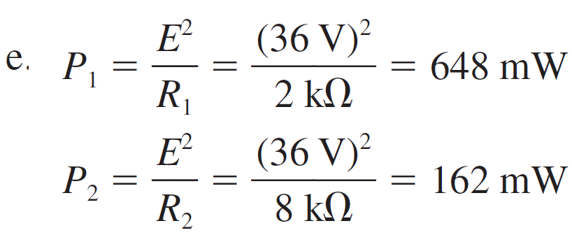
The Current Divider Rule (CDR)
EXAMPLE For the circuit of Figure shown, determine the following quantities:

Slide 84
The Current Divider Rule (CDR)
EXAMPLE For the circuit of Figure shown, determine the following quantities:

Slide 85
VOLTAGE SOURCES IN PARALLEL
Voltage sources are placed in parallel only if they have the same voltage rating. The primary reason for placing two or more batteries in parallel of the same terminal voltage would be to increase the current rating (and, therefore, the power rating) of the source.

Slide 86
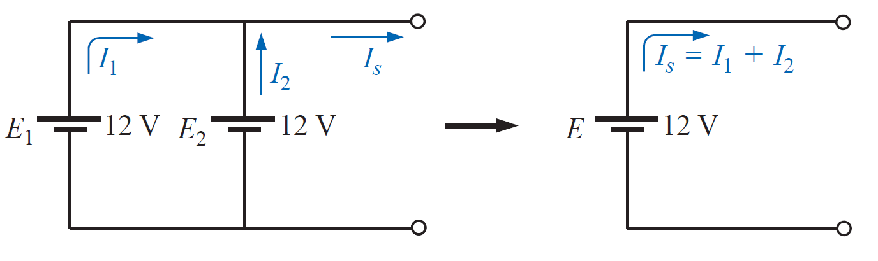
VOLTAGE SOURCES IN PARALLEL
Voltage sources are placed in parallel only if they have the same voltage rating. The primary reason for placing two or more batteries in parallel of the same terminal voltage would be to increase the current rating (and, therefore, the power rating) of the source.

Slide 87
VOLTAGE SOURCES IN PARALLEL
Voltage sources are placed in parallel only if they have the same voltage rating. The primary reason for placing two or more batteries in parallel of the same terminal voltage would be to increase the current rating (and, therefore, the power rating) of the source.

Slide 88
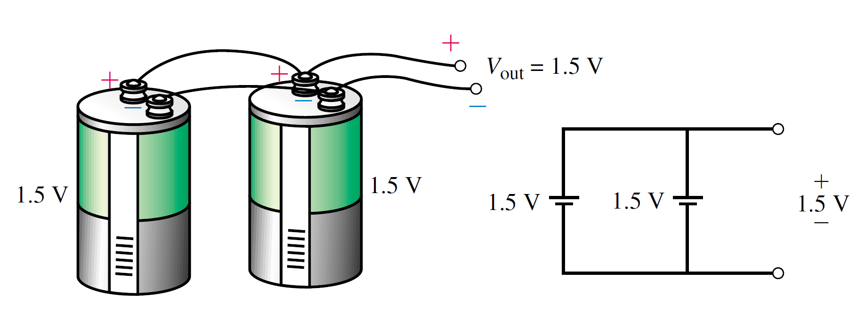
VOLTAGE SOURCES IN PARALLEL

Slide 89
OPEN AND SHORT CIRCUITS
A short circuit occurs when a low-resistance conductor such as a piece of wire or any other conductor is connected between two points in a circuit.
Due to the very low resistance of the short circuit, current will bypass the rest of the circuit and go through the short. An ohmmeter will indicate a very low (theoretically zero) resistance when used to measure across a short circuit.
An open circuit occurs when a conductor is broken between the points under test. An ohmmeter will indicate infinite resistance when used to measure the resistance of a circuit having an open circuit.

Slide 90
OPEN AND SHORT CIRCUITS

Slide 91
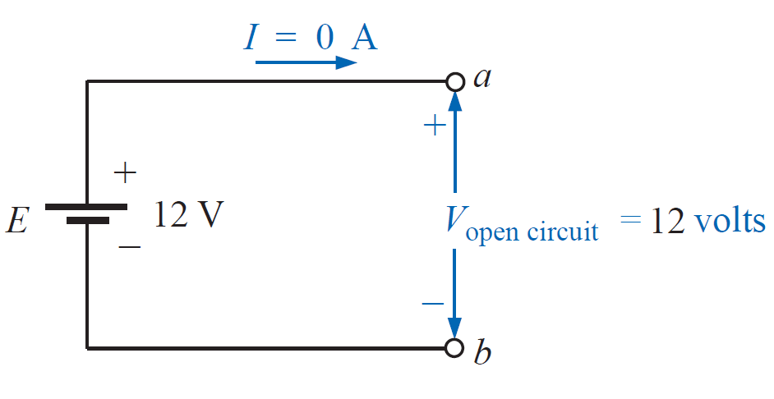
OPEN AND SHORT CIRCUITS
An open circuit can have a potential difference (voltage) across its terminals, but the current is always zero amperes.

Slide 92
OPEN AND SHORT CIRCUITS
An open circuit can have a potential difference (voltage) across its terminals, but the current is always zero amperes.

Slide 93
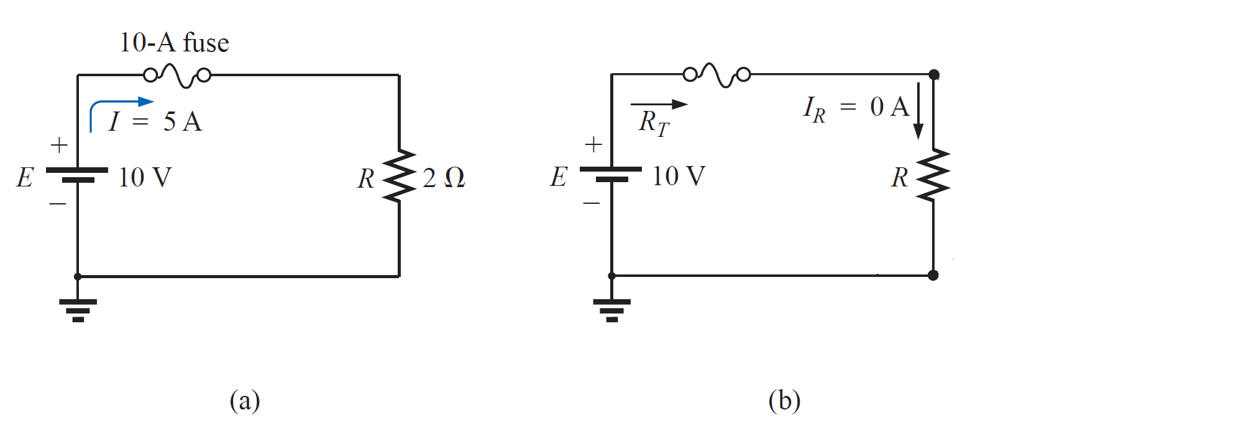
OPEN AND SHORT CIRCUITS
A short circuit can carry a current of a level determined by the external circuit, but the potential difference (voltage) across its terminals is always zero volts.

Slide 94
OPEN AND SHORT CIRCUITS
A short circuit can carry a current of a level determined by the external circuit, but the potential difference (voltage) across its terminals is always zero volts.

Slide 95
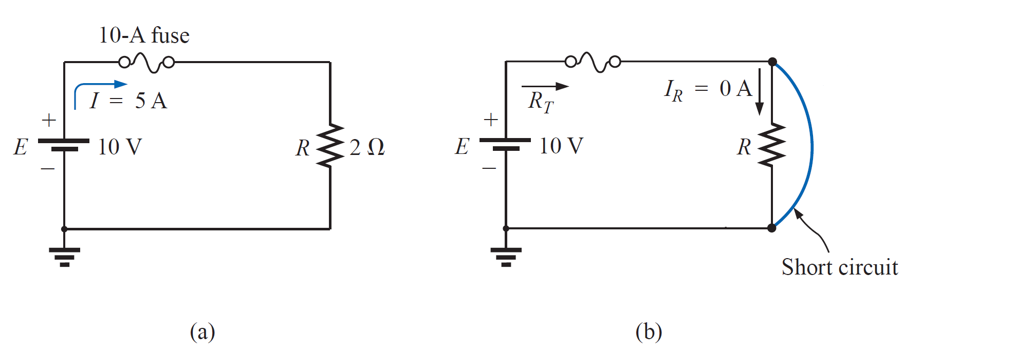
OPEN AND SHORT CIRCUITS
A short circuit can carry a current of a level determined by the external circuit, but the potential difference (voltage) across its terminals is always zero volts.

Slide 96
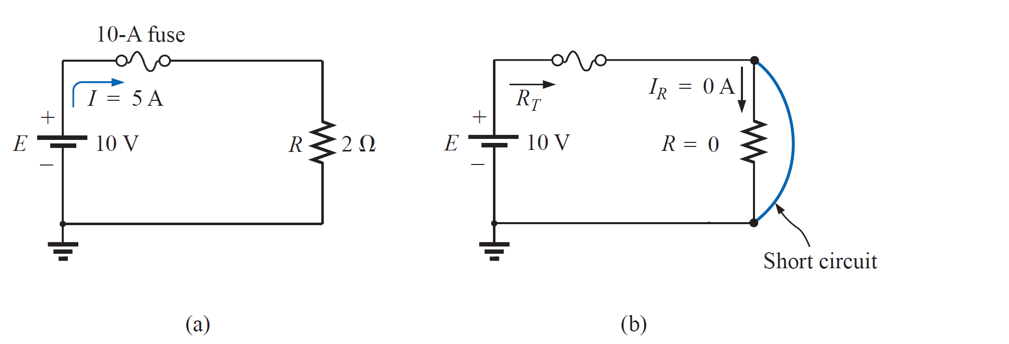
OPEN AND SHORT CIRCUITS
A short circuit can carry a current of a level determined by the external circuit, but the potential difference (voltage) across its terminals is always zero volts.

Slide 97
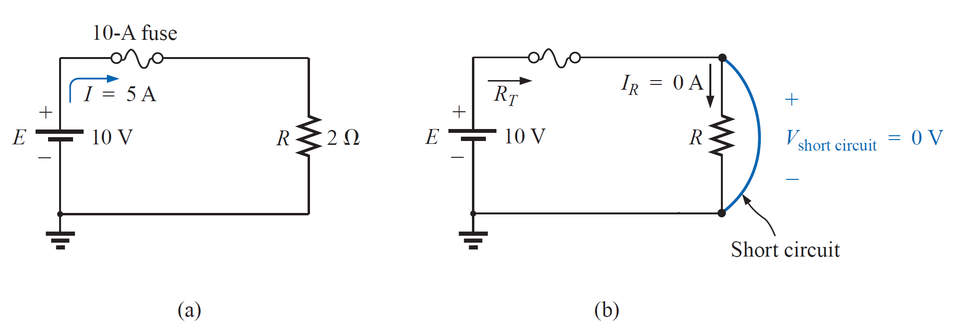

OPEN AND SHORT CIRCUITS
A short circuit can carry a current of a level determined by the external circuit, but the potential difference (voltage) across its terminals is always zero volts.

Slide 98
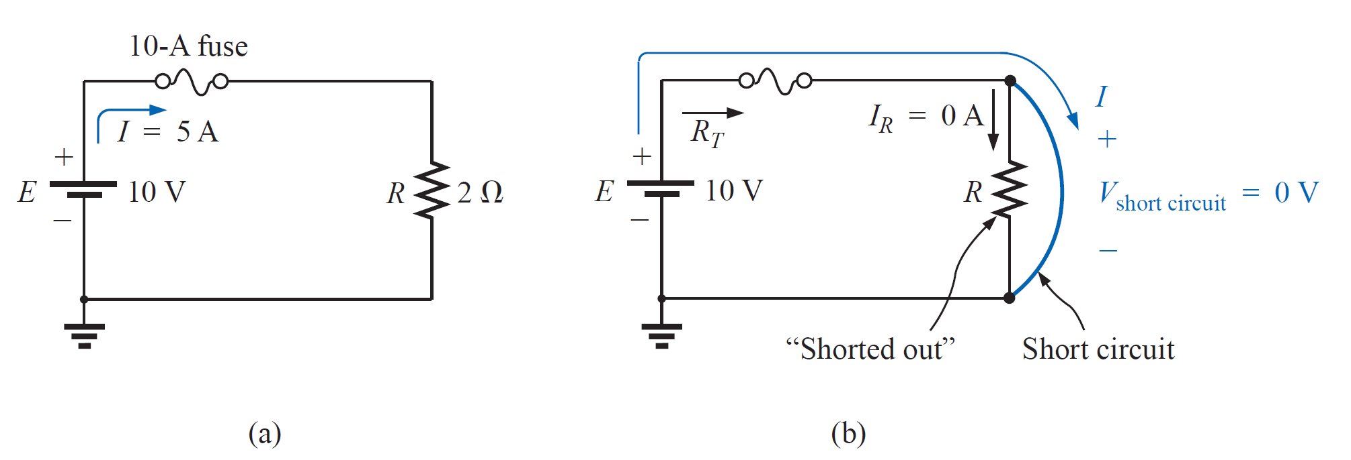
OPEN AND SHORT CIRCUITS
A short circuit can carry a current of a level determined by the external circuit, but the potential difference (voltage) across its terminals is always zero volts.

Slide 99
OPEN AND SHORT CIRCUITS
A short circuit can carry a current of a level determined by the external circuit, but the potential difference (voltage) across its terminals is always zero volts.

Slide 100
References
Boylestad, Robert L. Introductory circuit analysis. Pearson Education, 2010.
Robbins, Allan H., and Wilhelm C. Miller. Circuit analysis: Theory and practice. Cengage Learning, 2012.
Sadiku, Matthew NO, and Chales K. Alexander. Fundamentals of electric circuits. McGraw-Hill Higher Education, 2007.

